Slide 1
Display Summary Field and Display Snippet
In Primo VE NDE
Yoel Kortick | May 2026

Slide 2
Agenda
  Introduction
  Display Summary Field
  Display Snippet

Slide 3

Introduction

Slide 4
Introduction
The “Display Summary Field” is
  A descriptive label and summary information added to the brief record display in the Primo VE search results.
  Based on the 520 field of the record in the case of MARC21
A Snippet in Primo VE is
  A short text preview derived from the indexed full text of either
    An indexed full text document
    A full text digital file managed via Alma-D
  Part of the brief record display in the Primo VE search results. By providing to the user a small sample of text surrounding the search term, the user is given additional information about the resource.

Slide 5
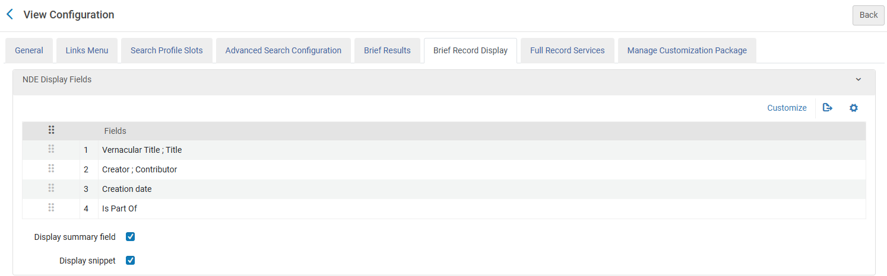
Introduction
In Primo VE NDE the option to display or not display the Summary Field and Snippet has been added to the “Brief Record Display” tab.

Slide 6
Display Summary Field

Slide 7
Display Summary Field
Currently we have defined to display the Summary Field

Slide 8
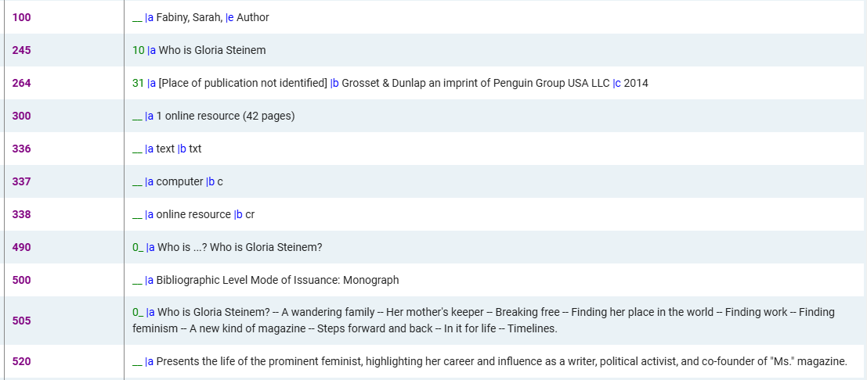
Display Summary Field
Bibliographic title “Who is Gloria Steinem” contains the following 520 field:

Slide 9
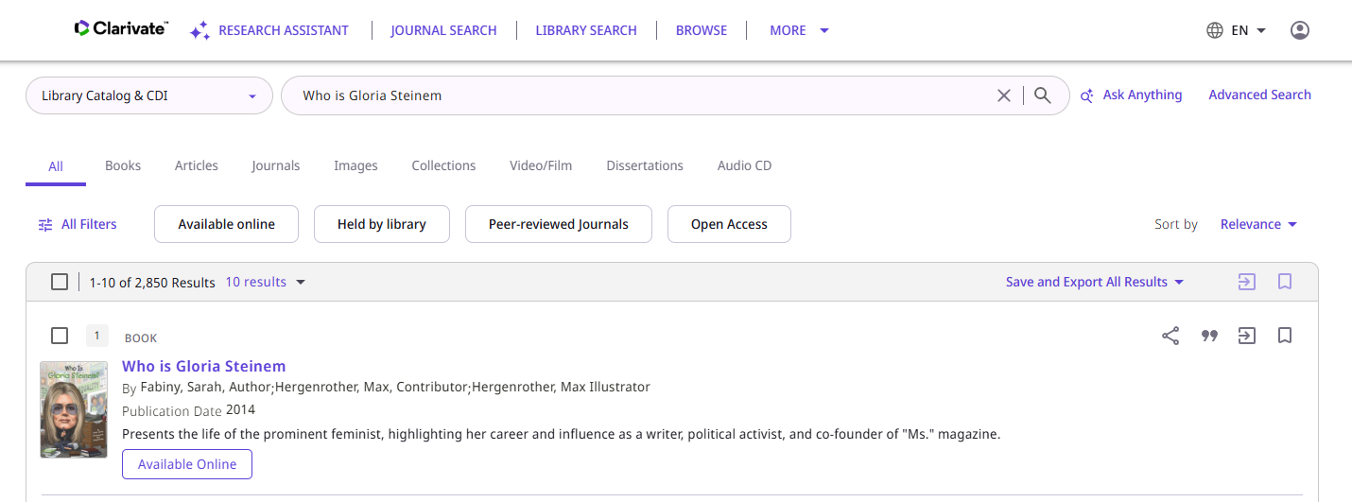
Display Summary Field
The summary field appears in the search results as part of the brief record Display

Slide 10
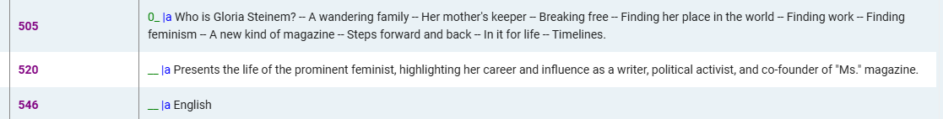
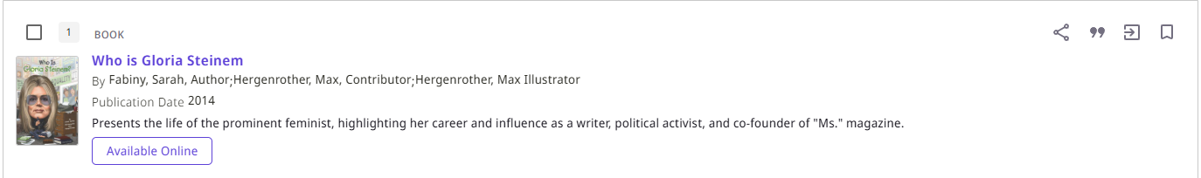
Display Summary Field
Here we see that the summary is coming from the 520 (summary field), in the case of a MARC21 record)

Slide 11
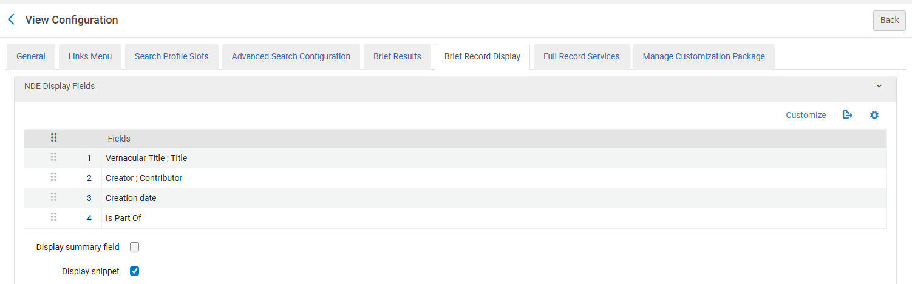
Display Summary Field
Currently we have not defined to display the Summary Field

Slide 12
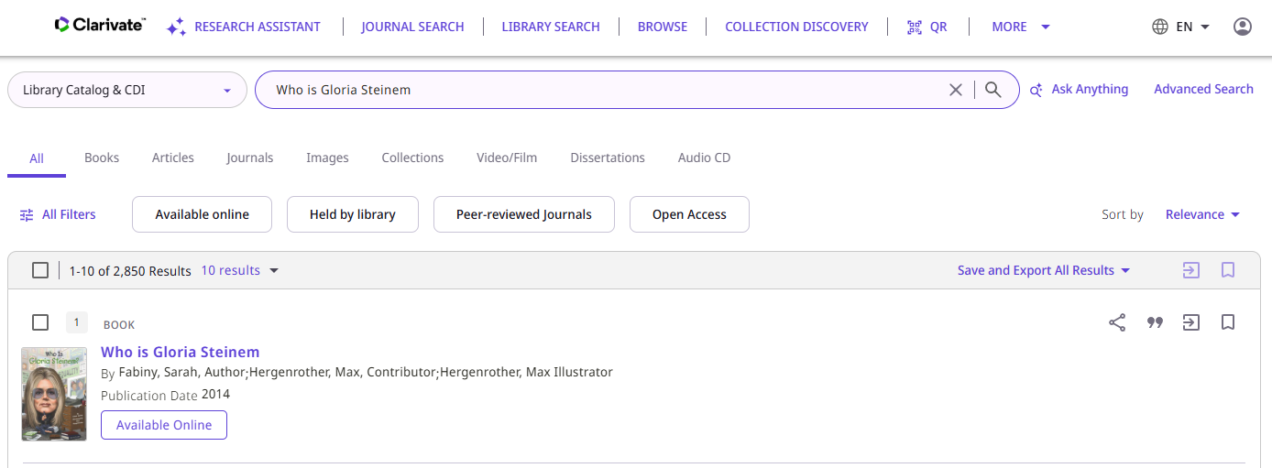
Display Summary Field
Now the summary field no longer displays
This is where the Summary field would be if it was displaying.

Slide 13
Display Snippet

Slide 14
Display Snippet
Currently we have defined to display the snippet

Slide 15
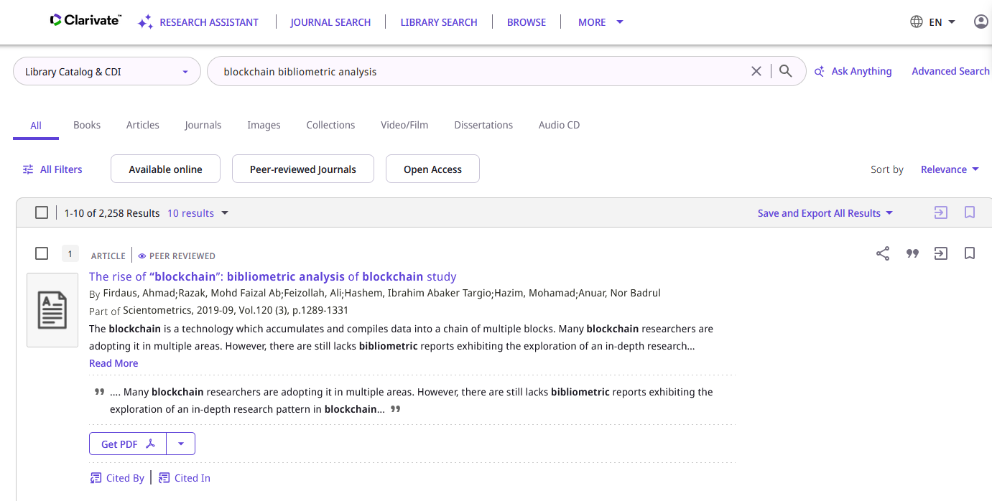
Display Snippet
We search “Library Catalog & CDI” for “blockchain bibliometric analysis” and see this snippet

Slide 16
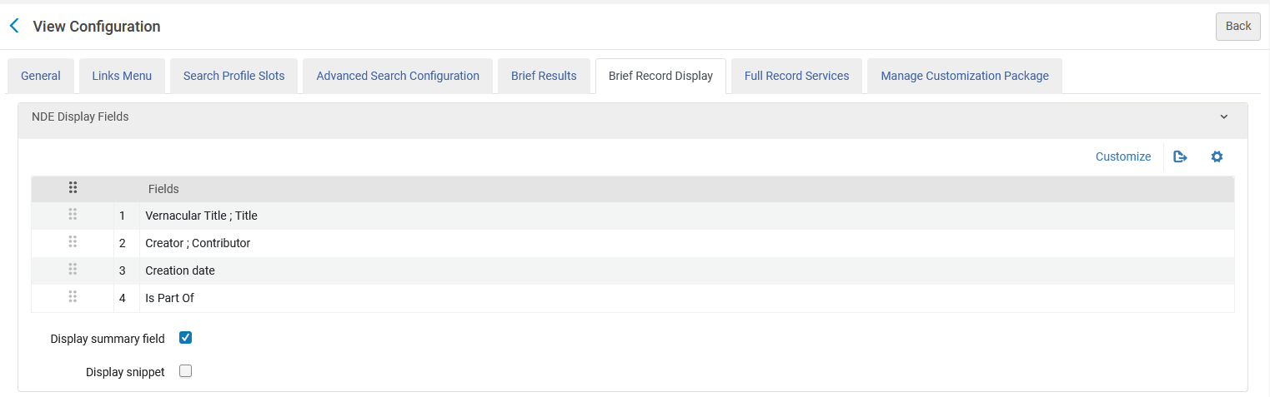
Display Snippet
Currently we do not have defined to display the snippet

Slide 17
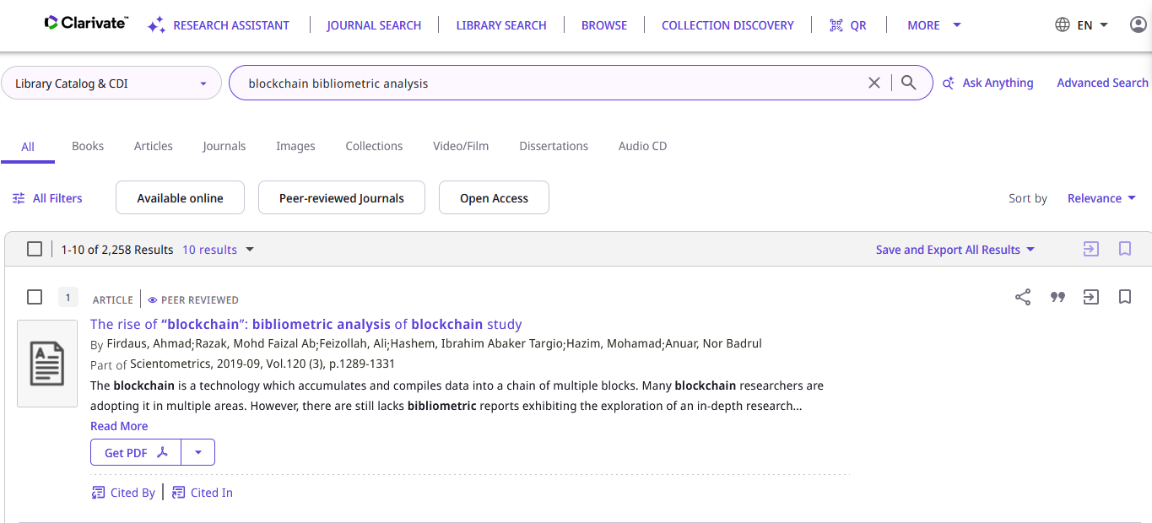
Display Snippet
We search “Library Catalog & CDI” for “blockchain bibliometric analysis” and do not see the snippet

Slide 18
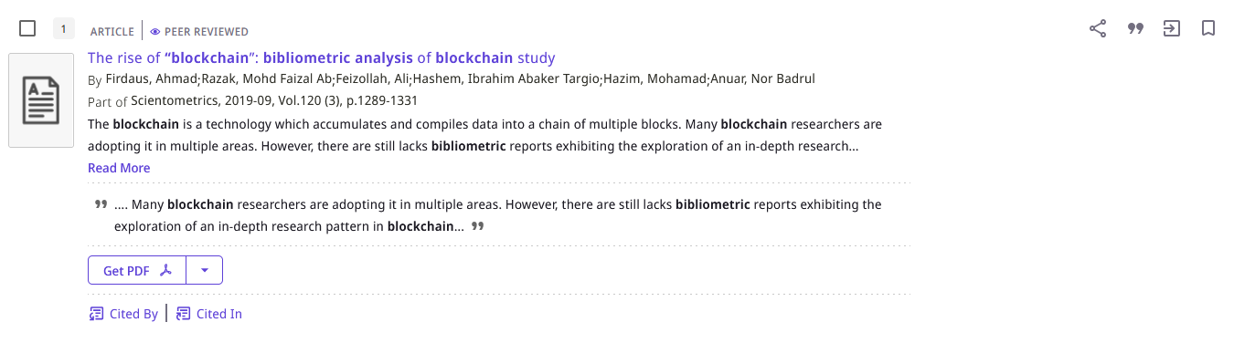
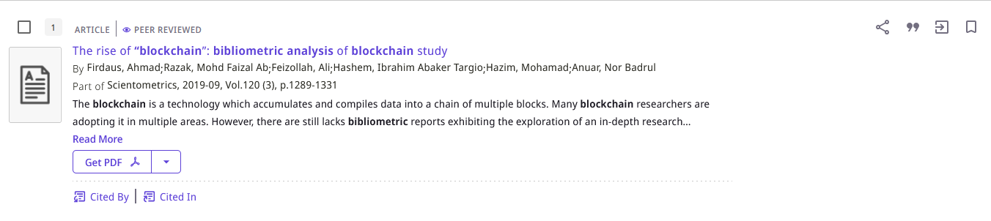
Display Snippet
When we do check “Display snippet” in the Primo View
When we do not check “Display snippet” in the Primo View

Slide 19
Thank You

